Slide 1
A Service API for deployment
Steve Loughran
HP Laboratories
steve_loughran@hpl.hp.com

Slide 2
Goals
Public face of CDDLM "Basic Services"
Widely usable deployment API
Language agnostic
Use core WS-I SOAP, if possible, for interoperability
Be rigorous (WSDL-first)
Be extensible
Explore what works, what doesn’t
Notes:
Last point is key. This is exploratory. Feedback welcome :)

Slide 3
XML Layer
SOAP1.1/1.2
WS-I level SOAP, plus WS-Addressing
Seven operations:
deploy
undeploy
serverStatus
applicationStatus
listApplications
setCallback
(lookupApplication)
~2000 lines of XML Schema!
Notes:
That's a lot of XML Schema. Partly that is from all the xsd:annotations, which persist into the generated source, and so are

Slide 4
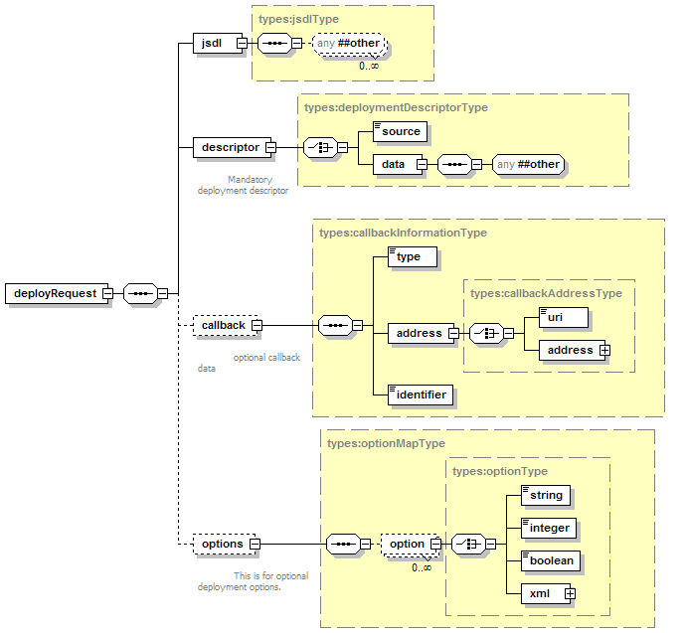
Deploy
Notes:
This is the most complex API.

Slide 5
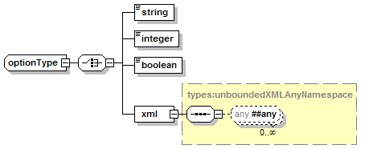
Deployment supports optional extensions
a list of options
  name: uri
  mustUnderstand:boolean
SOAPHeader semantics
Notes:
This is both wonderful and trouble.
Wonderful as it gives implementations the freedom to add specific customisations
Trouble as there is now the potential for differences in feature support.
validateOnly: don’t deploy, just verify
propertyMap: set late name/value bindings
name: a must-be-unique name for the application

Slide 6
defined optional extensions
validateOnly: validate descriptor, do not deploy
name: unique name for the application
propertyMap: name-value pairs of late binding information
extractable from configuration file (e.g by smartfrog PROPERTY) keyword.
Notes:
This is both wonderful and trouble.
Wonderful as it gives implementations the freedom to add specific customisations
Trouble as there is now the potential for differences in feature support.
validateOnly: don’t deploy, just verify
propertyMap: set late name/value bindings
name: a must-be-unique name for the application

Slide 7
JSDL Support
JSDL document can be included in the deploy request
Currently purely informative.
No coupling of stdin/stdout

Slide 8
Naming
URI for deployed applications.
  Unique to that machine
  use wall time and counter to keep unique over restarts
Option for explicit 'application name'
  SmartFrog runtime permits cross application resolution
  Proved to brittle for testing, let alone deployment
  Retained as a vestigial/optional feature
  Recommend: use real naming/dir/location services
Notes:
Issue of mild controversy, credit to Ed to pointing out where I was wrong.

Slide 9

undeploy
idempotent
asynchronous
not an error to undeploy a nonexistent application

Slide 10
applicationStatus
<applicationStatusResponse>
<reference>http://cddlm/job2</reference>
<name>job2</name>
<state>running</state>
<stateInfo xsi:nil="true" />
</applicationStatusResponse>
probes application health (blocking call)
optional arbitrary stateInfo

Slide 11
Callbacks
Lifecycle events
ApplicationURI + caller supplied identifier
Application Status
Faults can be included inline
Set callback on deploy()
setCallback() operation sets a callback on a running application
setCallback(null) to unsubscribe.
Notes:
Surprisingly hard to implement and test even simple callbacks.

Slide 12
Trouble with Callbacks
  No standard callback mechanism
  WS-Notification v. complex
  WS-Notification/WS-eventing convergence?
  Firewalls?
  Jabber/XMLPP goes through firewalls
  Prototype just has simple direct callback endpoint
  notifications are queued; failures ignored.

Slide 13
Implementation
Java based
Uses Apache Axis 1.2beta for SOAP
Built on SmartFrog
Hosted in SmartFrog (Axis Component, CDDLM component supplies a new endpoint)
Mildly Asynchronous (worker threads for notification callbacks)
Deploys SmartFrog descriptors
Parses and Validates XML-CDL descriptors

Slide 14
Architecture
deploy
undeploy
Axis
endpoint
serverStatus
worker queue
…
worker
worker
worker
job
Job Repository
job host
job
SmartFrog
Notes:
Requests come in to axis
this is dispatched to our endpoint
which dispatches each operation to a processor class
which either reacts immediately or queues an action
deployed jobs are kept in a (non-persistent) job repository
the job host can host deployed projects, and so keep track of lifecycle events
notifications are generated from the events and sent to callbacks via workers

Slide 15
Issue: Faults
Not using WS-BaseFaults: too inflexible
"BaseFault does NOT include open element extensibility"
requires explicit typing of all possible fault content
requires explicit naming of all throwable faults
the "checked exception" pattern
using classic SOAPFault
constants.xml declares fault codes
Notes:
First issue of controversy.
I like some aspects of WS-BaseFault: chaining model, explicit inclusion of address.
But it is like Java exceptions: you need to declare everything you can possibly throw. This is too restrictive for a generic interface.
The sole workaround is to declare a 'generic' extensible type and stick everything inside, but if you do that, why not stick with the broadly interoperable SOAPFaults. Which is what we did.

Slide 16
Not yet addressed
Logging
  need dynamic reconfig of running logs
  feeding of log data (buffered?) to monitors
  caching of data for polling
Code/data file provisioning
  assume portal copies files to shared file system
  could handle attachments, though that is an interop black spot.
Security
  (other than HTTP Authentication)

Slide 17
Next Steps
integrate with a front end (i.e. the iceni one)
integrate with a resource manager
review feedback from users, 2nd implementations
work on trouble areas: callbacks, faults, security, logging
implementation: XML-CDL support as it evolves

Slide 18





product placements:
Notes:
Plus the rest of the SmartFrog dev team who were both patient and helpful.

